Slide 1
Introduction to NoSQL
James Xue

Slide 2
Background
Relational databases → mainsteam of business
Web-based applications caused spikes
explosion of social media sites (Facebook, Twitter) with large data needs
rise of cloud-based solutions such as Amazon S3 (simple storage solution)
Hooking RDBMS to web-based application becomes trouble

Slide 3
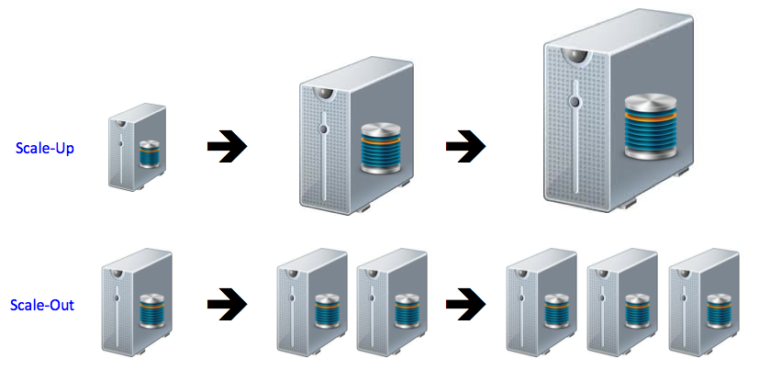
Scalability is the key for processing huge data

Slide 4

Scaling up vs Scaling out

Slide 5
Scaling Up
Best way to provide ACID and rich query model is to have the dataset on a single machine
Limits to scaling up (or vertical scaling: make a “single” machine more powerful) → dataset is just too big!

Slide 6
Scaling Out
Scaling out (or horizontal scaling: adding more smaller/cheaper servers) is a better choice
Different approaches for horizontal scaling (multi-node database):
Master/Slave
Sharding (partitioning)

Slide 7
Scaling out: Master/Slave
Master/Slave
All writes are written to the master
All reads performed against the replicated slave databases
Critical reads may be incorrect as writes may not have been propagated down
Large datasets can pose problems as master needs to duplicate data to slaves

Slide 8
Scaling out: Sharding
Sharding (Partitioning)
Scales well for both reads and writes
Not transparent, application needs to be partition-aware
Can no longer have relationships/joins across partitions
Loss of referential integrity across shards

Slide 9
NoSQL – the history
The Name:
Stands for Not Only SQL
The term NOSQL was introduced by Carl Strozzi in 1998 to name his file-based database
It was picked up again as Twitter hash tag in 2009 for NoSQL meet up in San Francisco organized by Johan Oskarsson.
A Rackspace employee Eric Evans made it popular by describing the NoSQL movement “the whole point of seeking alternatives is that you need to solve a problem that relational databases are a bad fit for …”

Slide 10
Problem for Relational Database to Scale
The Relational Database is built on the principle of ACID (Atomicity, Consistency, Isolation, Durability)
It implies that a truly distributed relational database should have availability, consistency and partition tolerance.
Which unfortunately is impossible …

Slide 11
3 major papers for NoSQL
Three major papers were the “seeds” of the NoSQL movement:
BigTable (Google)
DynamoDB (Amazon)
Ring partition and replication
Gossip protocol (discovery and error detection)
Distributed key-value data stores
Eventual consistency
CAP Theorem

Slide 12
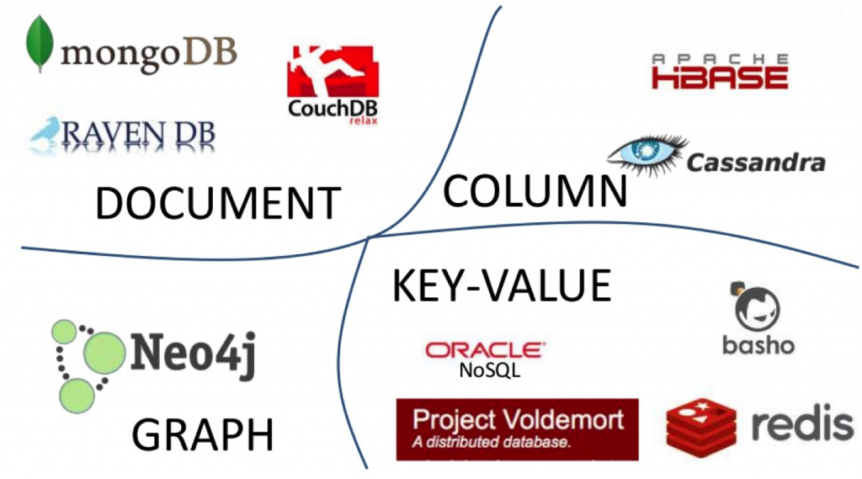
NoSQL Characteristics
Non-relational
Schema-less
data are replicated to multiple nodes (so, identical & fault-tolerant) and can be partitioned:
down nodes easily replaced
no single point of failure
Horizontal scalable
Cheap, easy to implement (open-source)
Massive write performance
Fast key-value access

Slide 13
NoSQL Characteristics
Don’t fully support relational features
no join, group by, order by operations (except within partitions)
no referential integrity constraints across partitions
No declarative query language (e.g., SQL) → more programming
Relaxed ACID (see CAP theorem) → fewer guarantees
No easy integration with other applications that support SQL

Slide 14
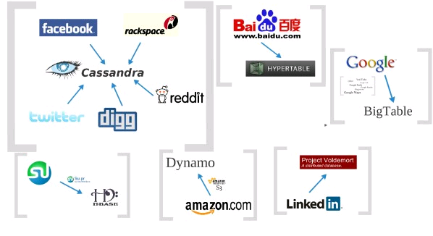
Who is using them?

Slide 15
NoSQL Categories
Key-value
Example: Dynamo, Voldermort, Scalaris
Document-based
Example: MongoDB, CouchDB
Column-based
Example: BigTable, Cassandra, Hbased
Graph-based
Example: Neo4J, InfoGrid

Slide 16
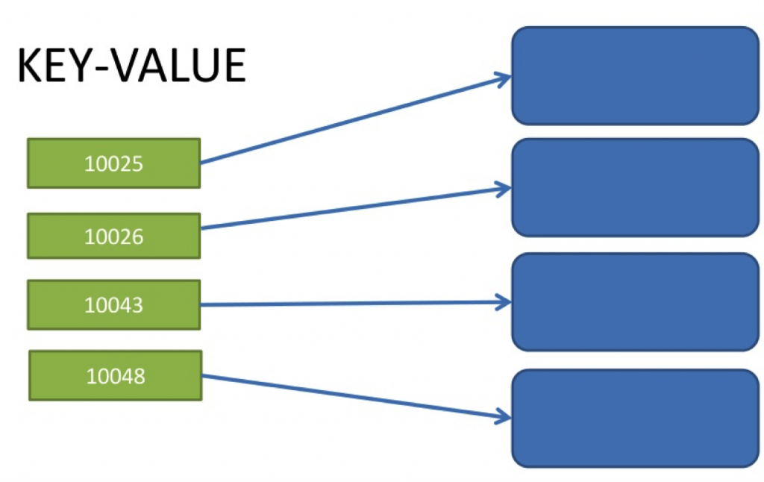
Key-value
Focus on scaling to huge amounts of data
Designed to handle massive Key-/value-stores have a simple data model in common: a map/dictionary, allowing clients to put and request values per key load
Based on Amazon’s dynamo paper
Data model: (global) collection of Key-value pairs
Modern key-value stores favor high scalability over consistency
The lengths of keys to be stored is limited to a certain number of bytes while there is less limitation on values.

Slide 17
Key-value
Basic API access:
get(key): extract the value given a key
put(key, value): create or update the value given its key
delete(key): remove the key and its associated value
execute(key, operation, parameters): invoke an operation to the value (given its key) which is a special data structure (e.g. List, Set, Map .... etc)
Notes:
-> http://chariotsolutions.blogspot.com/2010/01/why-you-need-nosql-in-your-toolbox.html

Slide 18
Key-value
Pros:
very fast
very scalable (horizontally distributed to nodes based on key)
simple data model
eventual consistency
fault-tolerance
Cons:
- Can’t model more complex data structure such as objects
Notes:
-> http://chariotsolutions.blogspot.com/2010/01/why-you-need-nosql-in-your-toolbox.html

Slide 19
Key-value
Name | Producer | Data model | Querying
SimpleDB | Amazon | set of couples (key, {attribute}), where attribute is a couple (name, value) | restricted SQL; select, delete, GetAttributes, and PutAttributes operations
Redis | Salvatore Sanfilippo | set of couples (key, value), where value is simple typed value, list, ordered (according to ranking) or unordered set, hash value | primitive operations for each value type
Dynamo | Amazon | like SimpleDB | simple get operation and put in a context
Voldemort | LinkeId | like SimpleDB | similar to Dynamo
Notes:
-> http://chariotsolutions.blogspot.com/2010/01/why-you-need-nosql-in-your-toolbox.html

Slide 20
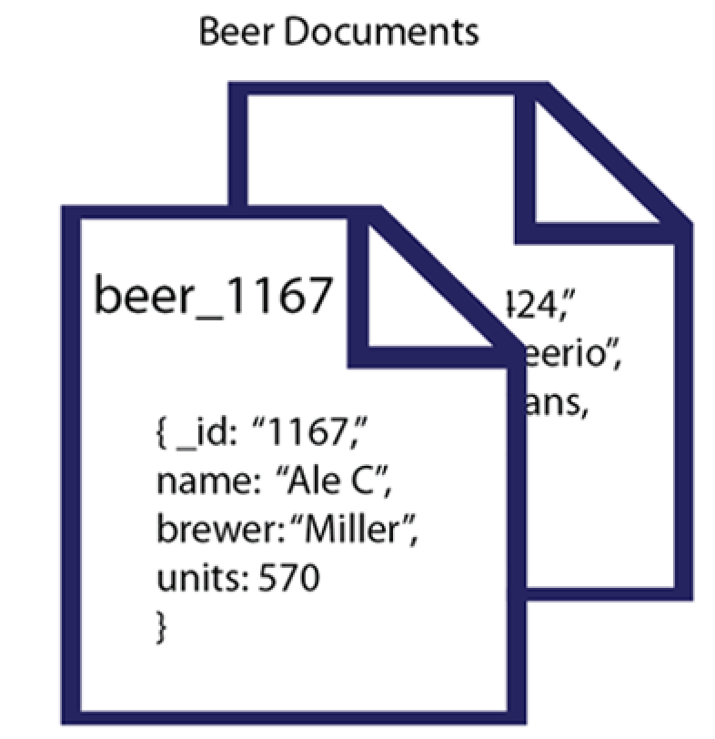
Document-based
Can model more complex objects
Inspired by Lotus Notes
Data model: collection of documents
JSON (JavaScript Object Notation is a data model, key-value pairs, which supports objects, records, structs, lists, array, maps, dates, Boolean, etc).
MongoDB data type: BSON (Binary Serialisation Object Notation, or Binary JSON)

Slide 21
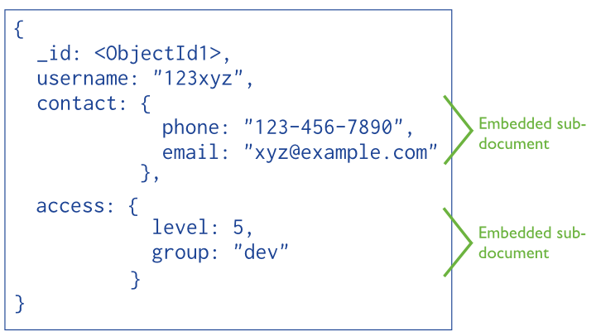
Document-based
Example: (MongoDB) document

Slide 22
Document-based
Name | Producer |  | Data model |  | Querying
MongoDB |  | 10gen |  | object-structured documents stored in collections; each object has a primary key called ObjectId |  | manipulations with objects in collections (find object or objects via simple selections and logical expressions, delete, update,)
Couchbase |  | Couchbase¹ |  | document as a list of named (structured) items (JSON document) |  | by key and key range, views via Javascript and MapReduce

Slide 23
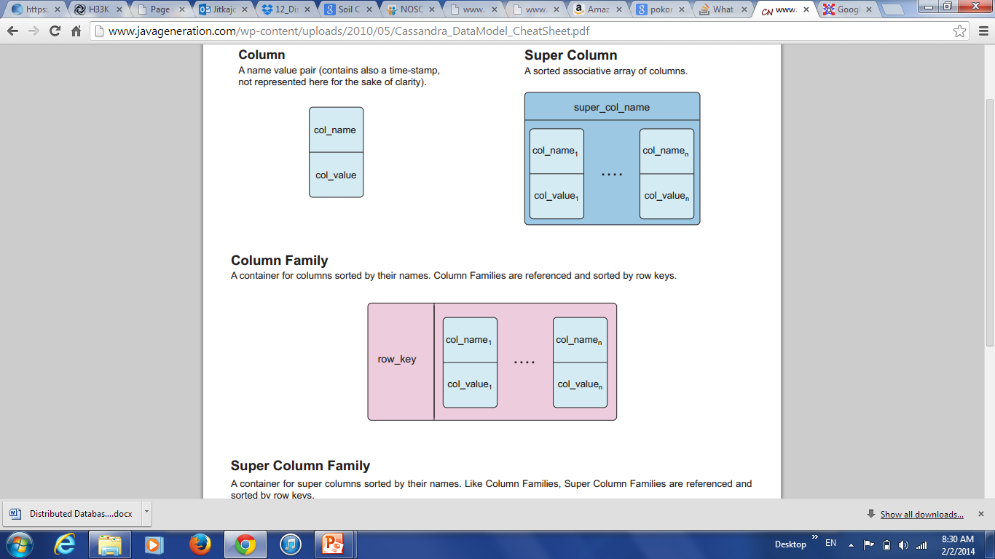
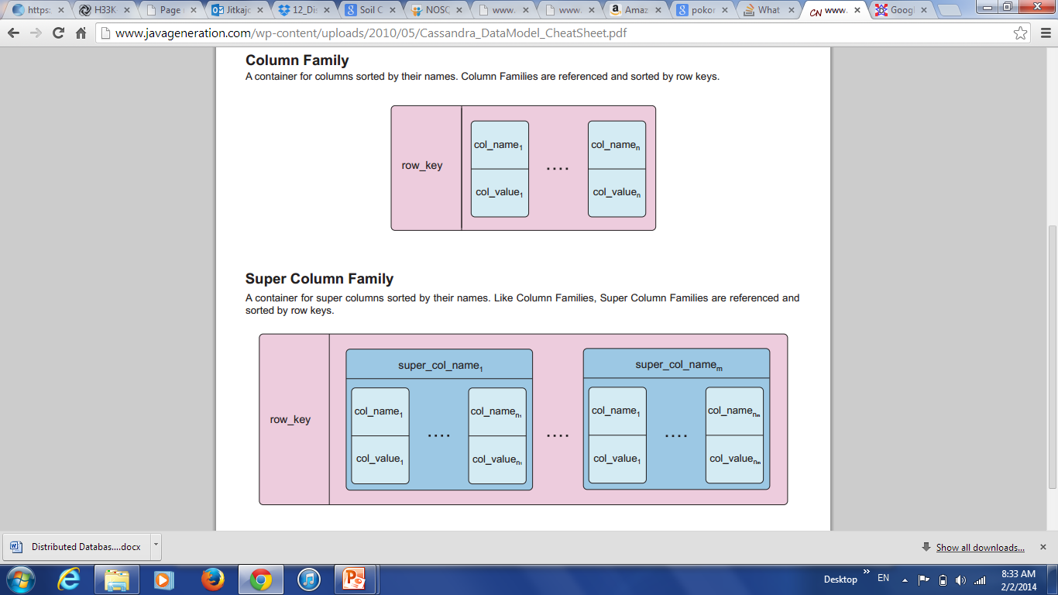
Column-based
Based on Google’s BigTable paper
Like column oriented relational databases (store data in column order) but with a twist
Tables similarly to RDBMS, but handle semi-structured
Data model:
Collection of Column Families
Column family = (key, value) where value = set of related columns (standard, super)
indexed by the triple (row key, column key and timestamp)
allow key-value pairs to be stored (and retrieved on key) in a massively parallel system
storing principle: big hashed distributed tables
properties: partitioning (horizontally and/or vertically), high availability etc. completely transparent to application
* Better: extendible records

Slide 24
Row Keys
Rows are kept in lexicographic order (dictionary-like) and are dynamically partitioned
Ordering of row keys directly influences the partitioning of rows.
Row keys are used for distribution and load balancing.

Slide 25
Column Family
The number of columns per table is not limited.
Columns are grouped by the key prefix into sets called column family.
Properties of column family:
Form the basic unit of access control, discerning privileges to list, read, modify and add column families
To store the same or similar type of data
Their data gets compressed together
The number of distinct column families in a table be small (hundreds at most).

Slide 26
Timestamp
Timestamps are used to discriminate different version of a cell value.
The value of a timestamp is either assigned by the data store (the actual timestamp of saving the cell value) OR chosen by client applications (and required to be unique).
Cell values are usually ordered in reversing order so that most recent version can be read first.

Slide 27
Column-based
Example: (Cassandra column family--timestamps removed for simplicity)
UserProfile = {
Cassandra = { emailAddress: “casandra@apache.org” , age: “20”}
TerryCho = { emailAddress: “terry.cho@apache.org” , gender: “male”}
Cath = { emailAddress: “cath@apache.org” , age: “20”, gender: “female”, address: “Seoul”}
}

Slide 28
Column-based
Name | Producer |  | Data model | Querying
BigTable |  | Google | set of couples (key, {value}) | selection (by combination of row, column, and time stamp ranges)
HBase |  | Apache | groups of columns (a BigTable clone) | JRUBY IRB-based shell (similar to SQL)
Hypertable |  | Hypertable | like BigTable | HQL (Hypertext Query Language)
CASSANDRA |  | Apache (originally Facebook) | columns, groups of columns corresponding to a key (supercolumns) | simple selections on key, range queries, column or columns ranges
PNUTS |  | Yahoo | (hashed or ordered) tables, typed arrays, flexible schema | selection and projection from a single table (retrieve an arbitrary single record by primary key, range queries, complex predicates, ordering, top-k)

Slide 29
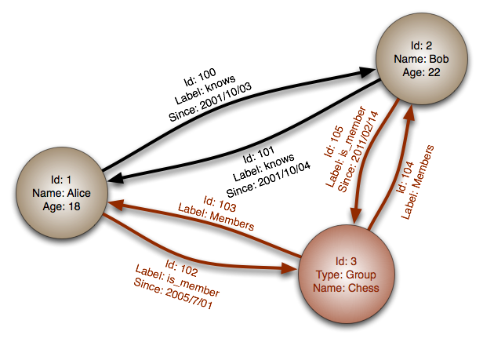
Graph-based
Focus on modeling the structure of data (interconnectivity)
Scales to the complexity of data
Inspired by mathematical Graph Theory (G=(E,V))
Data model:
(Property Graph) nodes and edges
Nodes may have properties (including ID)
Edges may have labels or roles
Key-value pairs on both
Interfaces and query languages vary
Single-step vs path expressions vs full recursion
Example:
Neo4j, FlockDB, Pregel, InfoGrid …

Slide 30
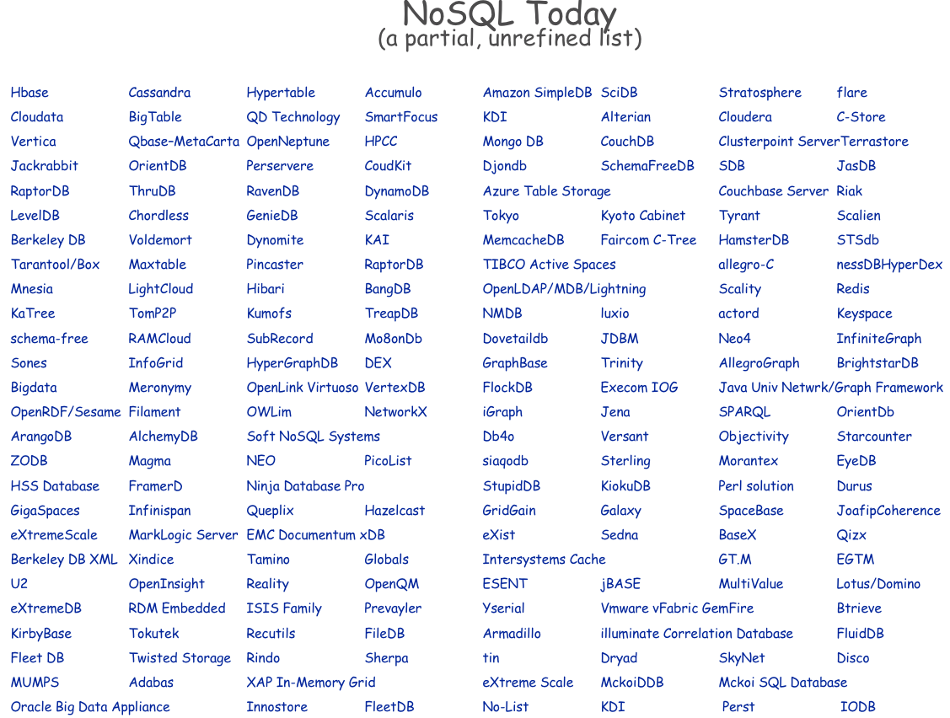

Slide 31
Resources
http://nosql-database.org/

